Slide 1
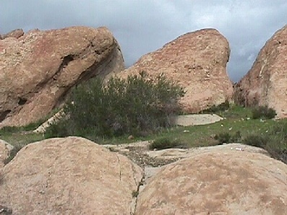
Forces in the Earth’s Crust Earth Comm: Understanding Your Environment, pages 43-47
Earth and Space Science

Slide 2
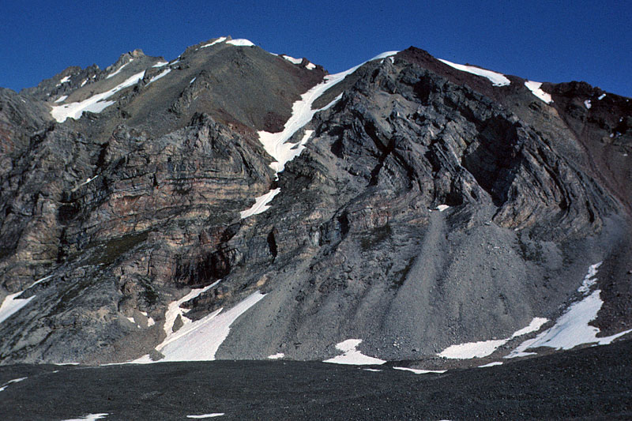
I. Forces in the Earth’s Crust
Natural forces fold, tilt, and move rock layers
→ These actions are called deformation
Can cause layers of rock to be folded, break,
and move

Slide 3
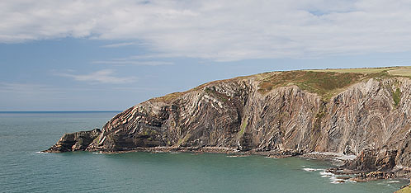
There are three types of forces that can deform rocks.

Slide 4
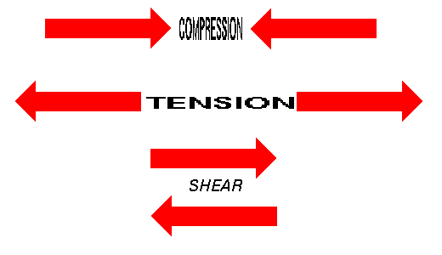
1. Tensional forces
– Forces which stretch / pull parts of the rock in opposite directions

Slide 5
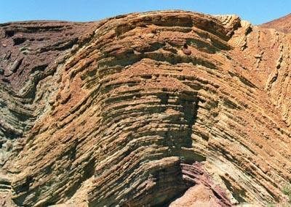
2. Compressional forces
– Forces that squeeze together parts of the rock

Slide 6
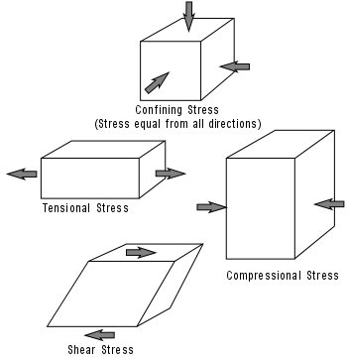
3. Shear forces
– Forces that try to cause materials to slide past
each other

Slide 7
They can act alone or as a combination
* If any of these forces are greater than the material’s strength, the material will deform
(bend, break, stretch, compress, twist, etc.)

Slide 8
A. Folding and Faulting

Slide 9
Temperature plays a key role as to what type of deformation occurs
Low temperature ➔ rocks are brittle and
break easily
- deform by fracturing / faulting
- generally the rocks in the upper crust are
cooler in temperature

Slide 10
Temperature plays a key role as to what type of deformation occurs
High temperature ➔ rocks tend to deform by changing in shape continuously instead of breaking
Generally the rocks in the lower crust are warmer in temperature

Slide 11
Folding is an example of how rocks can change their shape continuously without breaking

Slide 12
Speed of deformation plays a key role
→ if force builds up slowly = folding is more likely
→ if force builds up quickly = faulting is more likely

Slide 13
Fault
A crack in the lithosphere which can allow rock bodies to move past each other
→ can be caused by shear forces, compressional forces, and/or tensional forces or a combination

Slide 14
Folding
A bend in a layer of rock, usually due to deformation
- usually caused by compressional forces
- very common in layered rocks such as sedimentary

Slide 15
* These processes occur over long periods of time and cannot be directly observed in nature

